Slide 1





论文题目
论文评审评分系统
关键字：论文评审；自动化办公；毕业论文

Slide 2



为什么需要好的论文评审系统
更加环保
更加快捷
更加严谨
更加统一

Slide 3

系统架构
前后端分离
Vue
Element UI
Spring Boot
Vuex
axios
Spring Security
Spring Data JPA
Hibernate
MySQL

Slide 4

登录
学生
教师
管理员
身份验证
论文上传
论文下载
论文分配
论文下载
论文预览
得分统计
论文预览
论文评论
任务统计
论文评论
论文评分
学生管理
问题标签
教师管理

Slide 5



无状态身份认证
Spring Security & Json Web Token

Slide 6
多用户表身份认证
Spring Security & Json Web Token

Slide 7
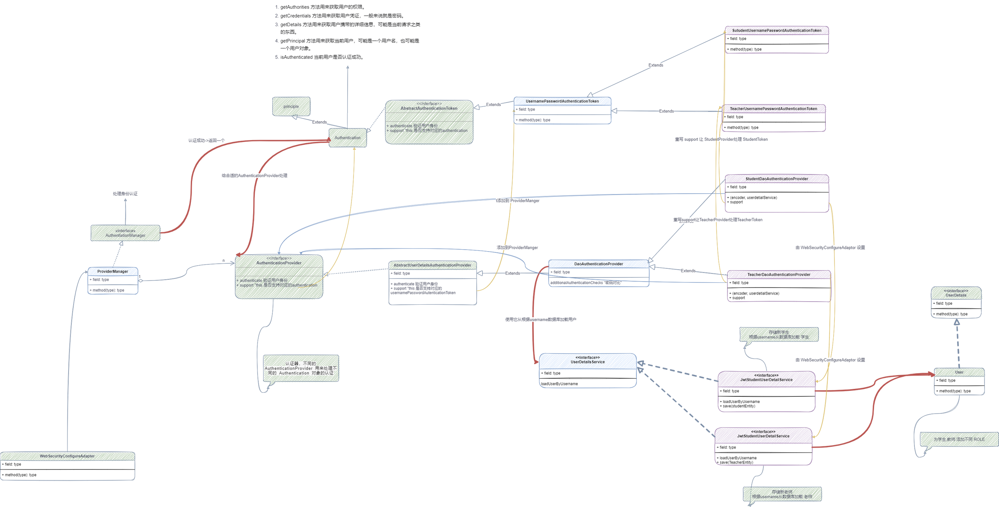

Slide 8
CORS
cross-origin resource share

Slide 9
多级查询
Hibernate & Spring Data JPA

Slide 10

Do you have any questions?

Slide 11
Thank you
Technology is best when it brings people together.
- Matt Mullenweg

Slide 12
Technology is best when it brings people together.
- Matt Mullenweg

Slide 13
Do you have any questions?
Send it to us! We hope you learned something new.

Slide 14
Presentation Highlights
Key points we will be discussing:
How technology has changed the way we shop
Life with and without online shopping
The ease of setting up an online shop
The importance of cybersecurity
The benefits tech brings to sellers and buyers

Slide 15


How technology has changed the way we shop
Gone are the days of going to malls, braving crowds, and walking through aisles for hours trying to find what we want. These steps have been replaced by a simple, fast, and convenient process that everyone can accomplish with access to the internet.

Slide 16

Life Before Online Shopping
Life With Online Shopping
Having to deal with traffic and parking at grocery stores and malls
Being able to save time as it only takes a few clicks to visit online shops
Spending hours picking out the right piece of item
Looking for items is made more accessible by well-designed online shops
Weaving through big crowds and lining up to pay for your purchase
Paying for purchases using easier and safer means without having to use cash

Slide 17


Step 1
Purchase a domain name
Use your brand as your domain name.
Step 2
Choose a secure e-commerce service
The ease of setting up an online shop
Do your research to see which ones are reliable and trustworthy.
Step 3
Get a secure SSL certificate
Gain the trust of your customers.
Step 4
Find an internet merchant account
Manage payments wisely.
Step 5
Select a payment service provider
Choose what's most convenient and reliable.

Slide 18
Item 5
20%
Item 1
20%
Revenue of Online Purchases by Industry
As of January 2021
Item 4
20%
Item 2
20%
Consumer spending continues to rise on furniture, sporting equipment, and household supplies.
Item 3
20%

Slide 19
The Benefits Tech Brings to Sellers and Buyers

Slide 20
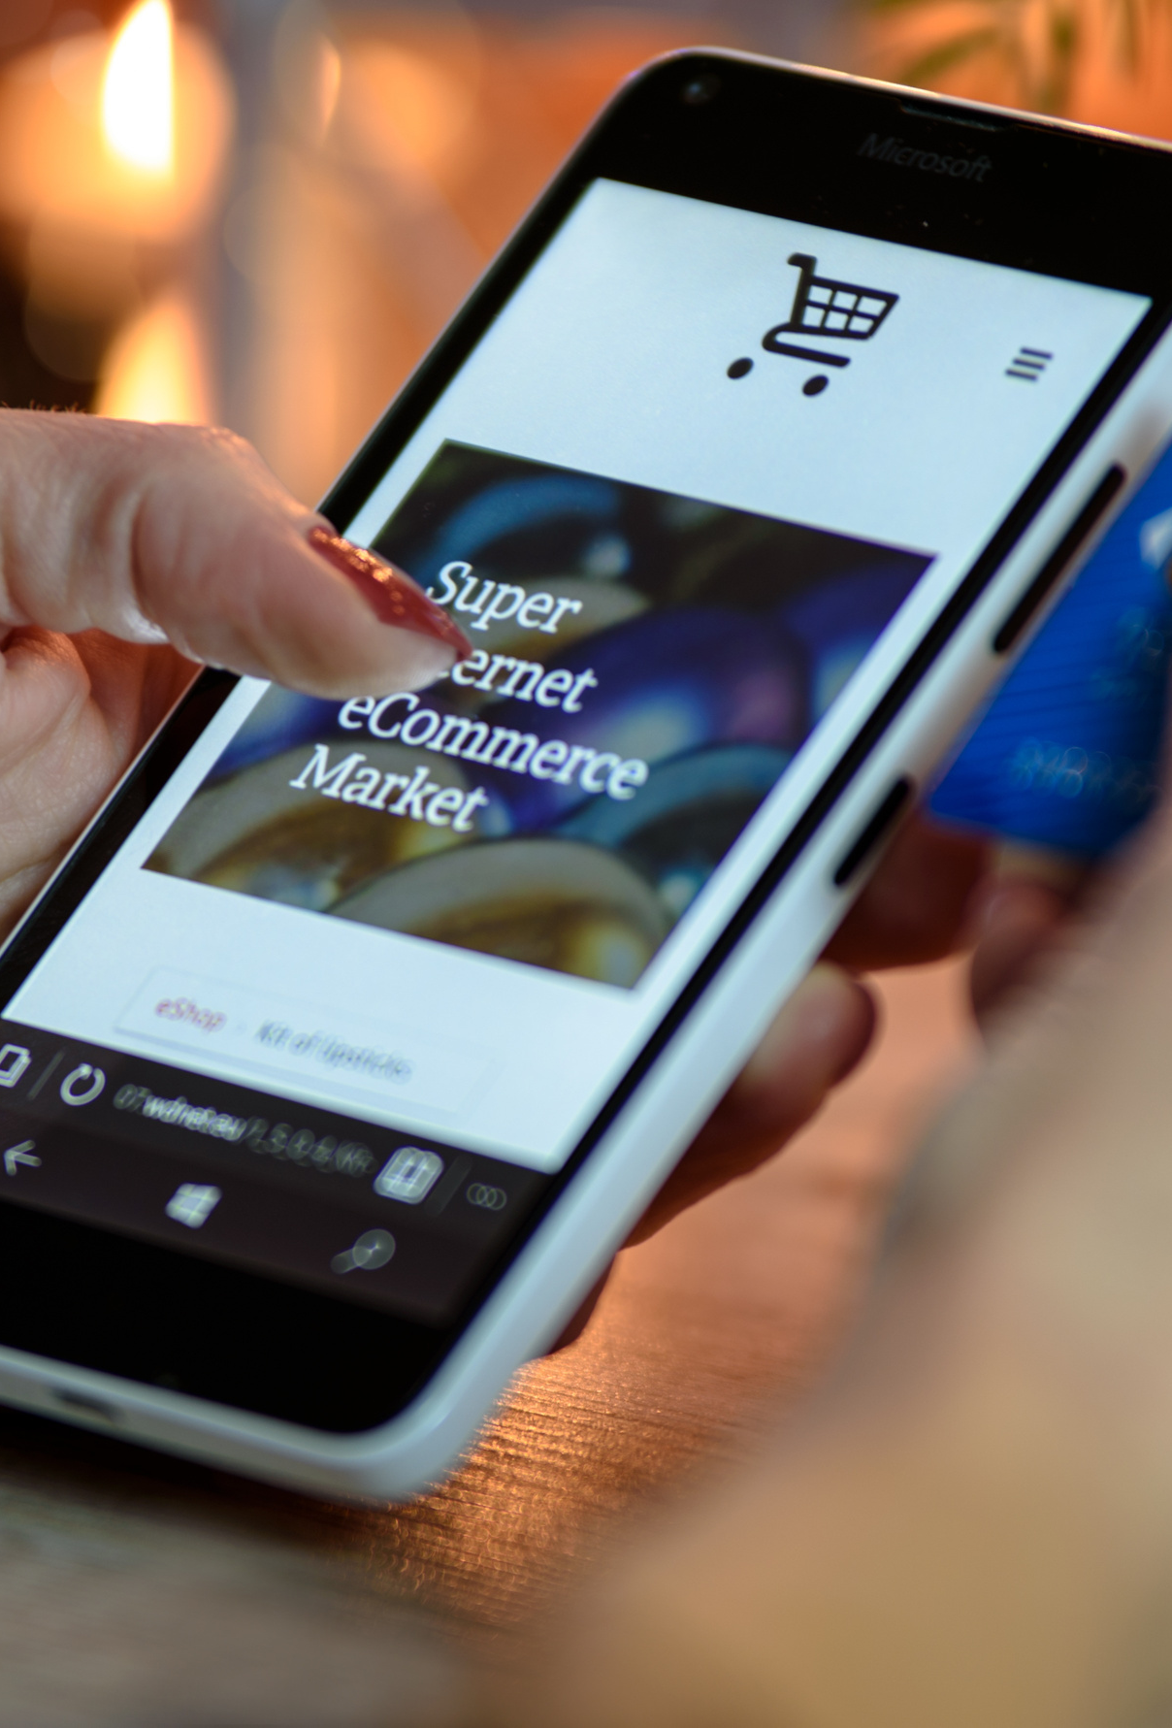
The Importance of Cybersecurity
Without online safety, everything just crumbles down
Do everything necessary to create a safe and secure space for your online business, like investing in cybersecurity and other systems to protect your data. Doing so will help you and your consumers avoid cyber threats and any malicious attacks online.

Slide 21

On Business Growth
Technology has significantly helped boost businesses
Marketing and Promotion
Operations and Management
Wider Reach
Introducing your company to the world has become easier and cheaper via different social media platforms.
Introducing your company to the world has become easier and cheaper via different social media platforms.
Introducing your company to the world has become easier and cheaper via different social media platforms.

Slide 22

Variety
Consumers now have access to millions of online stores worldwide and are able to see what a bigger selection of brands have to offer.
On Consumer Happiness
Ease and Comfort
With just a few clicks, consumers can buy everything they want and need in the comforts of their own home.
Better tech investment means happier, more satisfied customers
Secure and Fast Payment
Technology has introduced several ways to make sending and receiving payments more accessible and safer online.

Slide 23
The Deal with Online Ads
How your browsing habits affect the kind of ads you receive
As easy as it is to shop online, it's even easier for brands to encourage consumers to shop a lot more because of the prevalence of ads online. The algorithm knows what you want, and so it keeps presenting all these different products it believes you might be interested to buy.

Slide 24
Do your research and learn more about the most reliable online tools you can use to avoid unwanted ads.

Slide 25




What's Next in Ecommerce
Shipping and order fulfillment as a competitive advantage.
Warehouse automation
Adoption of environmentalism and sustainability
Continuous investment in cybersecurity and security technology.
The continuous rise of artificial intelligence and chat bots.

Slide 26
Free Resources
Send it to us! We hope you learned something new.

